Slide 1

INTRODUCTION TO UNIX/LINUX SYSTEMS
What is Unix?

Slide 2
UNIX is a portable, multitasking, multiuser, time sharing operating system(OS).
Founder of UNIX
The UNIX was founded by Ken Thompson, Dennis Ritchie and Brain kerninghan at AT& T Bell Labs research in 1969.

Slide 3
Linux
Linux OS being an open source OS, its source code is available for free. You can, therefore, read, modify and implement it on your machine. However, you cannot sell it as it comes under the GNU GPL License.
GNU GPL License: General Public License (GNU GPL or simply GPL) is a family of CopyLeft software licenses that guarantee end users the right to run, study, share, and modify software. The licenses were originally written by Richard Stallman, founder of the Free Software Foundation (FSF), GNU Project, and were released in 1989.

Slide 4
Founder of LINUX Linus Benedict Torvalds in 1991
There are comparatively more distributions or versions of Linux operating systems. The distributions available for Linux are as follows:
Redhat
Kali
Slackware
Debian
ArchLinux
Solaris
Ubuntu
CentOS
Fedora

Slide 5
Difference between UNIX and LINUX (linux is a unix clone)
UNIX | LINUX
It is a multi tasking, multiuser operating system | It is a free and open source software.
Developed by ken Thompson, Dennis Ritchie and Brain Kerninghan | Developed by Linus Benedict Torvalds
Source code is not available to general public. | Source code is available to general public
Not portable | Portable
Solaris, HP UNIX are some versions | Ubuntu, Fedora are some versions
Initially it was command based OS, but later Common Desktop Environment was created. Most Unix distributions use Gnome. | Linux is command based but some distros provide GUI based Linux. Gnome and KDE are mostly used GUI.
Unix has three distributions IBM AIX, HP-UX and Sun Solaris. Apple also uses Unix to make OSX operating system. | Linux kernel is developed by the community of developers from different parts of the world. Although the father of Linux, Linus Torvalds oversees things.

Slide 6
Different between Linux vs Windows and Linux vs Dos
Which would be preferable and why?

Slide 7
Linux Operating System
Linux is an open-source operating system. As it is open-source, it is special and different from other operating systems, which means that you can customize it by editing source code. It provides programming as well as a graphical user interface. Linux is built by Linux Torvalds because he wanted to create a free operating system kernel that anyone can use.

Slide 8
Linux is a collection of operating systems that are based on Linux kernel. The first version of Linux was released in the year 1991. The Linux system is most commonly used for servers; however, it is available in desktop versions as well.
Ubuntu, Debian, and Fedora are some popular Linux distributions. Also, we have SUSE Linux Enterprise Server (SLES) and RedHat Enterprise Linux for the commercial distribution of Linux. As it is open-source, we can modify the source code and make variations in the operating system.

Slide 9
The pros and cons of using Linux
Some advantages of using Linux include:
Open source software. The Linux kernel is released under the GNU GPL open source software license. Most distros include hundreds of applications, with many options in almost every category. Many distributions also include proprietary software, such as device drivers provided by manufacturers, to support their hardware.
Licensing costs. Unlike Microsoft Windows or Apple macOS, Linux has no explicit licensing fees. While system support is available for a fee from many Linux vendors, the OS itself is free to copy and use. Some IT organizations have increased their savings by switching their server software from a commercial OS to Linux.
Reliability. Linux is considered a reliable OS and is well-supported with security patches. Linux is also considered to be stable, meaning it can run in most circumstances. Linux also copes with errors when running software and unexpected input.

Slide 10
Many choices. Between the hundreds of available distributions, thousands of applications and almost infinite options for configuring, compiling and running Linux on almost any hardware platform, it is possible to optimize Linux for almost any application.
Backward compatibility. Linux and other open source software tend to be updated frequently for security and functional patches, while retaining core functionality. Configurations and shell scripts are likely to work unchanged even when software updates are applied. Unlike commercial software vendors that roll out new versions of their OSes along with new ways to work, Linux and open source applications generally don't change their modes of operation with new releases.

Slide 11
Some disadvantages of using Linux
Lack of established standard. There is no standard version of Linux, which may be good for optimizing Linux for particular applications, but less so for deploying standardized server or desktop images. The wide range of options can complicate support as a result.
Support costs. While an organization can acquire Linux freely without licensing fees, support is not free. Most enterprise Linux distributors like SUSE and Red Hat offer support contracts. Depending on the circumstances, these license fees can reduce savings significantly.
Proprietary software. Desktop productivity software like Microsoft Office cannot be used on Linux desktops, and other proprietary software may be unavailable for Linux platforms.

Slide 12
Unsupported hardware. While many hardware manufacturers make Linux device drivers available for their products, many do not.
Steep learning curve. Many users struggle to learn to use the Linux desktop or Linux-based applications.

Slide 13
What is systems Administration

Slide 14
A system administrator is a professional who maintains computer systems, servers, and networks of their clients.
System administrators (sysadmins) are professionals who support multiuser computing environments and ensure the smooth operation of IT services.

Slide 15
System Administrator - Roles and Responsibilities
The roles and responsibilities of a system administrator can vary widely from one organization to another. Here are the four types of system administrators based on their roles and responsibilities:
Network Administrators
Network administrators manage the entire network infrastructure of an organization. They design and install computer systems, routers, switches, local area networks (LAN), wide area networks (WAN), and intranet systems. They also monitor the systems, provide maintenance and troubleshoot any problems when they arise.

Slide 16
Database Administrators
Database administrators (DBA) set up and maintain databases used in an organization. They may also be required to integrate data from an old database into a new one or even create a database from scratch. In large organizations, there are specialized DBAs who are only responsible for managing databases. In smaller organizations, the roles of DBAs and server administrators can overlap.
Server/Web Administrators
Server or web administrators specialize in maintaining servers, web services and operating systems of the servers. They monitor the speed of the internet to make sure that everything runs smoothly. They also analyze a website’s traffic patterns and implement changes based on user feedback.

Slide 17
Security Systems Administrators
Security systems administrators monitor and maintain the security systems of an organization. They develop organizational security procedures and also run regular data checkups - setting up, deleting and maintaining user accounts.
In large organizations, all these roles may all be separate positions within one department. In smaller organizations, they may be shared by a few system administrators, or even one single person.

Slide 18
Understanding the Unix/Linux file system hierarchy
Linux Filesystem follows a tree-like hierarchical layout that is governed by the Filesystem Hierarchy Standard (FHS).
This is a standard maintained by the Linux Foundation.
The Linux Filesystem structure starts at the very top with the root directory which is the uppermost directory in the hierarchy. It contains all the directories and subdirectories on the system as we shall see later on in this guide.

Slide 19
In a Linux system, all files are stored on file systems. A file-system hierarchy is the organization of these files into a single inverted tree of directories.
The tree of directories is said to be inverted since its root at the top of the hierarchy, and the branches of directories and sub-directories stretch below the root.

Slide 20
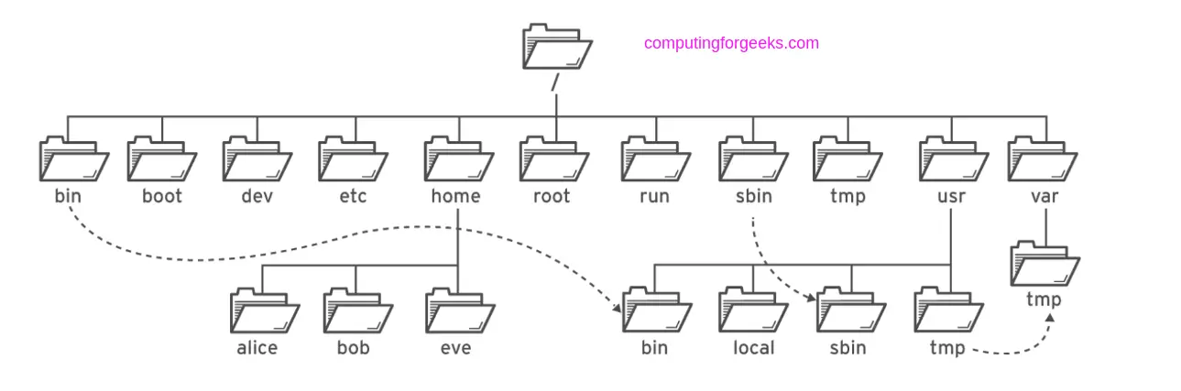

Slide 21
Type of Files in Linux
In Linux and UNIX systems, everything is considered a file. If not, then it’s a running process. Generally, all files in Linux fall into either of these three categories.
Regular files: These include text files, photos, videos, programs, and executable files.
Directories: This might sound a bit strange, but in Linux, directories are also considered files since they provide storage for other files and subdirectories.
Special files: These are device files that comprise symbolic links, block files, socket files, and named pipe files.

Slide 22
Dir | Description
/ | The directory called “root.” It is the starting point for the file system hierarchy. Note that this is not related to the root, or superuser, account.
/bin | Binaries and other executable programs.
/etc | System configuration files.
/home | Home directories.
/opt | Optional or third party software.
/tmp | Temporary space, typically cleared on reboot.
/usr | User related programs.
/var | Variable data, most notably log files.

Slide 23
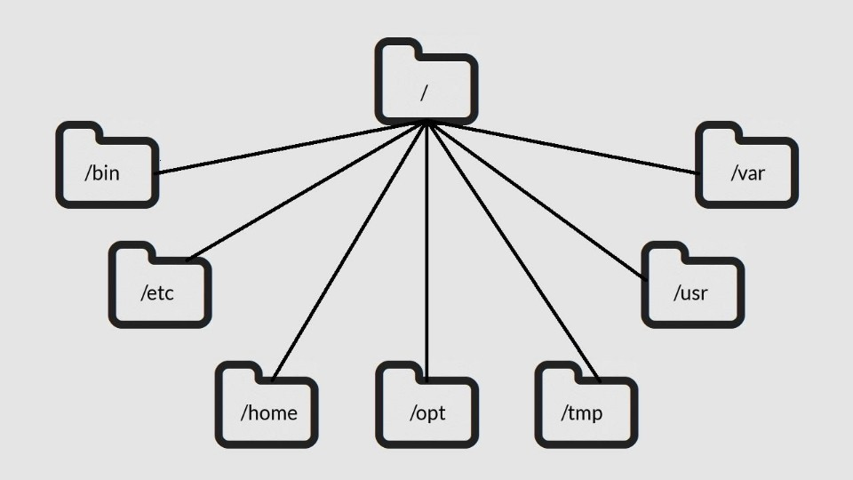

Slide 24
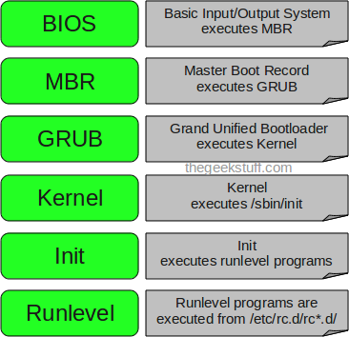
6 Stages of Linux Boot Process (Startup Sequence)

Slide 25
1. BIOS
BIOS stands for Basic Input/Output System
Performs some system integrity checks
Searches, loads, and executes the boot loader program.
It looks for boot loader in floppy, cd-rom, or hard drive. You can press a key (typically F12 of F2, but it depends on your system) during the BIOS startup to change the boot sequence.
Once the boot loader program is detected and loaded into the memory, BIOS gives the control to it.
So, in simple terms BIOS loads and executes the MBR boot loader.

Slide 26
2. MBR
MBR stands for Master Boot Record.
It is located in the 1st sector of the bootable disk. Typically /dev/hda, or /dev/sda
MBR is less than 512 bytes in size. This has three components 1) primary boot loader info in 1st 446 bytes 2) partition table info in next 64 bytes 3) mbr validation check in last 2 bytes.
It contains information about GRUB (or LILO in old systems).
So, in simple terms MBR loads and executes the GRUB boot loader.

Slide 27
3. GRUB
GRUB stands for Grand Unified Bootloader.
If you have multiple kernel images installed on your system, you can choose which one to be executed.
GRUB displays a splash screen, waits for few seconds, if you don’t enter anything, it loads the default kernel image as specified in the grub configuration file.
GRUB has the knowledge of the filesystem (the older Linux loader LILO didn’t understand filesystem).
Grub configuration file is /boot/grub/grub.conf (/etc/grub.conf is a link to this). The following is sample grub.conf of CentOS.

Slide 28
#boot=/dev/sda
default=0
timeout=5
splashimage=(hd0,0)/boot/grub/splash.xpm.gz
hiddenmenu
title CentOS (2.6.18-194.el5PAE)
root (hd0,0)
kernel /boot/vmlinuz-2.6.18-194.el5PAE ro root=LABEL=/
initrd /boot/initrd-2.6.18-194.el5PAE.img

Slide 29
As you notice from the above info, it contains kernel and initrd image.
So, in simple terms GRUB just loads and executes Kernel and initrd images.

Slide 30
4. Kernel
Mounts the root file system as specified in the “root=” in grub.conf
Kernel executes the /sbin/init program
Since init was the 1st program to be executed by Linux Kernel, it has the process id (PID) of 1. Do a ‘ps -ef | grep init’ and check the pid.
initrd stands for Initial RAM Disk.
initrd is used by kernel as temporary root file system until kernel is booted and the real root file system is mounted. It also contains necessary drivers compiled inside, which helps it to access the hard drive partitions, and other hardware.

Slide 31
5. Init
Looks at the /etc/inittab file to decide the Linux run level.
Following are the available run levels
0 – halt
1 – Single user mode
2 – Multiuser, without NFS
3 – Full multiuser mode
4 – unused
5 – X11
6 – reboot

Slide 32
Init identifies the default initlevel from /etc/inittab and uses that to load all appropriate program.
Execute ‘grep initdefault /etc/inittab’ on your system to identify the default run level
If you want to get into trouble, you can set the default run level to 0 or 6. Since you know what 0 and 6 means, probably you might not do that.
Typically you would set the default run level to either 3 or 5.

Slide 33
6. Runlevel programs
When the Linux system is booting up, you might see various services getting started. For example, it might say “starting sendmail …. OK”. Those are the runlevel programs, executed from the run level directory as defined by your run level.
Depending on your default init level setting, the system will execute the programs from one of the following directories.
Run level 0 – /etc/rc.d/rc0.d/
Run level 1 – /etc/rc.d/rc1.d/
Run level 2 – /etc/rc.d/rc2.d/
Run level 3 – /etc/rc.d/rc3.d/
Run level 4 – /etc/rc.d/rc4.d/

Slide 34
Run level 5 – /etc/rc.d/rc5.d/
Run level 6 – /etc/rc.d/rc6.d/

Slide 35
Please note that there are also symbolic links available for these directory under /etc directly. So, /etc/rc0.d is linked to /etc/rc.d/rc0.d.
Under the /etc/rc.d/rc*.d/ directories, you would see programs that start with S and K.
Programs starts with S are used during startup. S for startup.
Programs starts with K are used during shutdown. K for kill.
There are numbers right next to S and K in the program names. Those are the sequence number in which the programs should be started or killed.
For example, S12syslog is to start the syslog deamon, which has the sequence number of 12. S80sendmail is to start the sendmail daemon, which has the sequence number of 80. So, syslog program will be started before sendmail.

Slide 36
Logging in and basic shell commands
login is used when signing onto a system. It can also be used to switch from one user to another at any time (most modern shells have support for this feature built into them, however).If an argument is not given, login prompts for the username.

Slide 37
The login process in Linux typically involves several steps, particularly when logging in via a command-line interface (CLI) or a graphical user interface (GUI). Here's a general outline of the steps involved in the login process for a Linux system:
Boot Process: When the computer is powered on or restarted, the BIOS (or UEFI) firmware initializes hardware components and loads the bootloader. The bootloader, such as GRUB (Grand Unified Bootloader), loads the Linux kernel into memory.

Slide 38
Init is the first process started during system boot. It is a daemon process that continues running until the system is shut down. Init is the direct or indirect ancestor of all other processes, and automatically adopts all orphaned processes.

Slide 39
Logging in to a Unix system requires two pieces of information: A username, and a password.
login:
Type your username at the login prompt, and press the return key. The system will then ask you for your password. When you type your password, the screen will not display what you type.

Slide 40
Your username
Your username is assigned by the person who creates your account. At ISU, the standard username is the first four letters of your last name concatenated with the first four letters of your first name.
Your username must be unique on the system where your account exists since it is the means by which you are identified on the system.
Your password
When your account is created, a password is assigned. The first thing you should do is change your password, using the passwd utility. To change your password, type the command
passwd

Slide 41
Logging Out
When you're ready to quit, type the command
exit
Before you leave your terminal, make sure that you see the login prompt, indicating that you have successfully logged out. If you have left any unresolved processes, the Unix system will require you to resolve them before it will let you log out. Some shells will recognize other commands to log you out, like "logout" or even "bye".
It is always a good idea to clear the display before you log out, so that the next user doesn't get a screenful of information about you, your work, or your user account. You can type the command
clear
right before you log out, or you can press the return key until all the information is scrolled off the screen.

Slide 42
The 4 Main Types of User Accounts on Linux
User accounts are a key concept on Linux. Primarily, they help you manage access control on your system. In addition, they allow multiple users to log in at any given time, and they are critical for the security of a system.
Without user accounts, it would be hard to control who has access to what part of a Linux system. Linux has four main types of user accounts.

